Slide 1
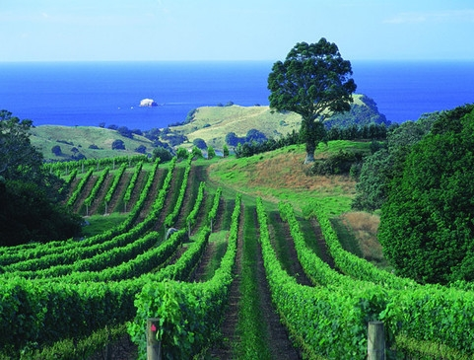
Nya Zeeland
Vinprovning 24.4.2014
Handelsgillet i Helsingfors

Slide 2
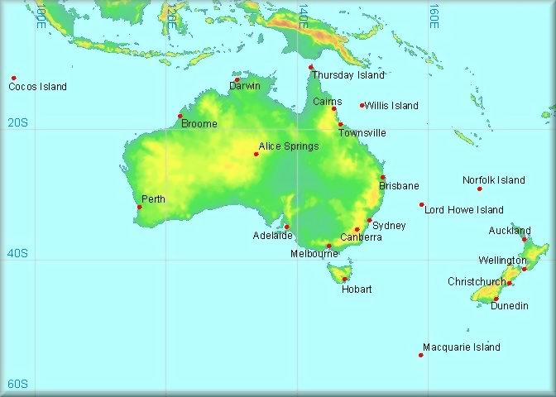
Nya Zeeland

Slide 3
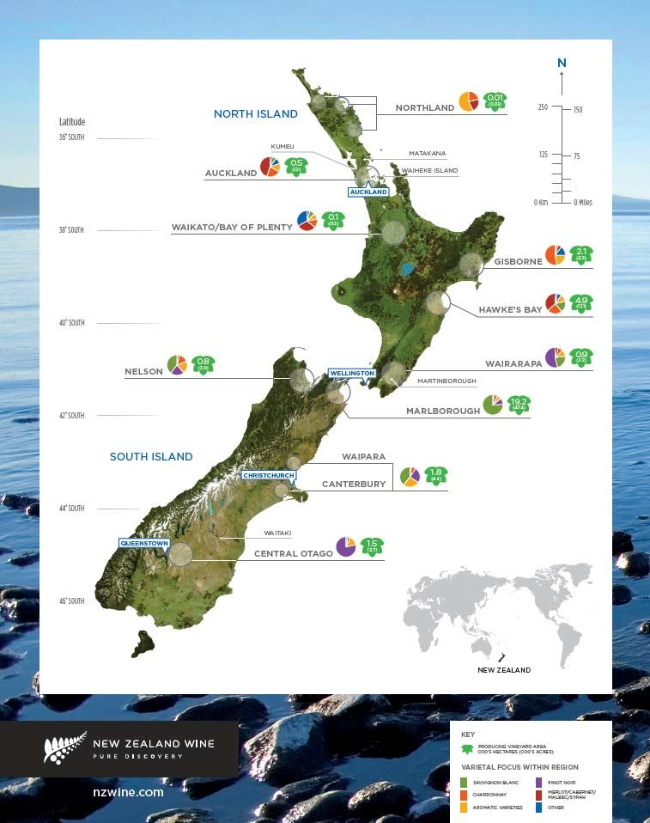

Slide 4

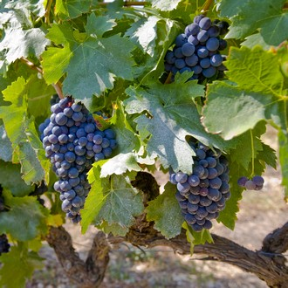
Viner i kväll
Sauvignon Blanc
Chardonnay
Pinot Noir
Syrah

Slide 5
2012 Saint Clair, Vicar´s Choice, Brut, 14,86€
Mycket torr, hög syra, inslag av svartvinbärsblad, krusbärig, citruskaraktär, örtig
Tillverkning: I ståltank.
Producent: Saint Clair Family Estates, grundat 1994. Ägare till vinhuset är Neal och Judy Ibbotson som har bedrivit vinodling i Marlborough sedan 1978. Saint Clair Family Estates förfogar över sex vingårdar runt om i Marlborough.
Annat: Namnet Vicar’s Choice, Kyrkoherdens val, är en hyllning till vinhusets egen familjepräst som var särskilt förtjust i de första viner man producerade
Alkohol | 13.00 %
Extrakt: | 25 g/l
Syror: | 7.3 g/l
Socker: | 5 g/l
Energi: | 80 kcal / 100 ml (340 kJ / 100 ml)

Slide 6
2012 Saint Clair, Vicar´s Choice, Brut
Winemaker: Matt Thomson and Hamish Clark
Colour: Pale straw with green hues.
Aroma: A lifted nose showing fruit punch aromas, fresh green tomato leaf, blackcurrant, grapefruit and melon, with refreshing underlying mineral notes.
Palate: Fresh herbaceous style that shows classic Marlborough varietal character and zest. Flavours of blackcurrant, grapefruit and melon are carried through with a lively sparkle.
Ageing potential: Perfect for drinking immediately or over the next three years.
Winemaking: Grapes were transported to the winery with haste and pressed off with minimal skin contact, the resulting juice then cool fermented in stainless steel to retain freshness and character. The wine is carefully balanced to provide a refreshing and persistent off-dry finish enlivened by bubbles.
Viticulture: Selected especially for a sparkling wine style, the fruit was sourced from several vineyards including the Lower Wairau and Spring Creek sub-regions.
Wine Analysis: Alcohol: 13%, Titratable Acidity: 7.8g/l, Residual Sugar: 4.4g/l, pH: 3.33.
Food match: Enjoy on its own or try with fresh New Zealand oysters or hors d’oeurves.

Slide 7
2012 Saint Clair, Pioneer Block, Sawcut, Chardonnay, 21,80€
Torr, hög syra, inslag av gula plommon, citruskaraktär, kryddig, gräddig, ekig, rostad
Produktionsområde:
Sawcut Vineyard i regionen Marlborough.
Tillverkning:
Druvorna samlades in för hand. Alkoholjäsningen skedde enbart i franska ekfat varav 40 procent var nya. Därefter följde malolaktisk jäsning och lagring på fällningen i tio månader före buteljering.
Producent:
Saint Clair Family Estates, ett vinhus grundat 1994. Ägarna heter Neal och Judy Ibbotson som har bedrivit vinodling i Marlborough sedan 1978. Saint Clair Family Estates förfogar över sex vingårdar runt om i Marlborough.
Annat:
Vingården Sawcut har döpts efter en närbelägen ravin.
Alkohol: | 13,50 %
Extrakt: | 24 g/l
Syror: | 5,4 g/l
Socker: | 4 g/l
Energi: | 80 kcal / 100 ml (350 kJ / 100 ml)

Slide 8
2012 Saint Clair, Chardonnay
BLOCK: 4
The Sawcut Vineyard is named after the Sawcut Gorge, located within the Ure Valley (Marlborough).
Region:
The Ure Valley is an area of Marlborough 50 km south of the township of Blenheim. It is a narrow valley floor, protected by hills on three sides, and has very close proximity to the east coast. It has a unique micro climate, ideally suited to the production of top-quality wine.
Soils: Free draining river valley alluvial soils. This valley is noted for very high limestone content.
Topography: Flat, on a plateau within the narrow valley.
Climate: A relatively warm site despite being significantly south. It has a similar number of growing degree days as Blenheim
Flavours: The high pH and limestone soils impact significantly on the flavour of this wine giving it palate weight and fruit intensity. It also contributes a mineral note on the palate.
Viticulture: The fruit was sourced from a single vineyard on free draining river valley soils. The grapes are 100 percent clone 95 Chardonnay, a clone that originates in Burgundy. This block is one of the earliest vineyard sites to be harvested.

Slide 9
2012 Saint Clair, Chardonnay
Winemaking: The fruit was hand-picked when it reached full physiological ripeness and maximum flavour maturity. At the winery the fruit was whole bunch pressed to ensure the best fruit flavours were preserved. After settling, the juice was inoculated with selected yeast strains. The wine was 100 per cent barrel fermented in French oak (20 per cent new and 80 per cent seasoned). The wine then went through malolactic fermentation, followed by 10 months ageing on yeast lees with regular stirring. The wine was then carefully blended, stabilised and prepared for bottling.
Colour: Pale gold
Aroma: Lifted aromas of nectarine and white peach with a hint of spicy oak.
Palate: This elegant chardonnay shows flavours of nectarine and white peach supported by underlying minerality and spicy oak characters.
Cellaring: Drinking well now and patient cellaring will reward over the next one to five years.
Analysis Alcohol: 13.5% v/v, Titratable Acidity: 5.8g/litre, Residual Sugar: 3.7g/litre, pH: 3.52.
Food Match: Perfect on its own or as an accompaniment to chicken and pasta dishes.

Slide 10
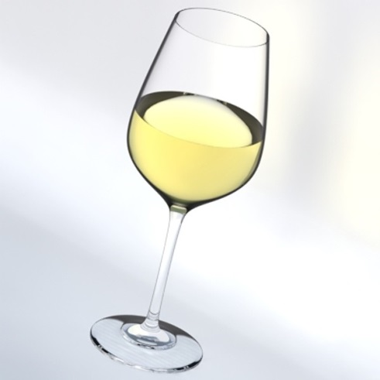
2013 Cloudy Bay, Sauvignon Blanc, 28,70€
Torr, mycket hög syra, limekaraktär, grönvinbärskaraktär, örtig, nässlig, mineralig, renrasig, lång
Alkohol: | 13,50 %
Extrakt: | 19 g/l
Syror: | 7,7 g/l
Energi: | 80 kcal / 100 ml (350 kJ / 100 ml)

Slide 11
2013 Cloudy Bay
Current Tasting Notes Zesty lime and grapefruit aromas are the first to emerge from the nose of our 2013 sauvignon blanc, followed by nectarine and lemongrass tones. The palate is fresh and focused with ripe citrus, stonefruit, fennel and mineral notes lingering on the persistent finish. Our sauvignon blanc is a delicious partner to a tomato and goat curd salad drizzled with fresh basil oil.
Vineyard Notes Grapes for our sauvignon blanc are sourced from estate and grower vineyards located in the Rapaura, Fairhall, Renwick and Brancott sub-regions of the Wairau Valley. Soils range from free draining stony on the valley floor to aged alluvial loams containing some clay. The majority of fruit is grown on a vertical shoot positioned (VSP) trellis with a small number of blocks on Scott-Henry. In 2013, our average sauvignon blanc yield was 10 tonnes/ha.
Production Notes Harvest 2013 was rather compressed with varieties ripening at similar rates due to the remarkably uniform growing season. Harvest of our sauvignon blanc fruit commenced on March 29th with the first fruit coming in from the Rapaura and Renwick subregions. The compact harvest lasted just two weeks, finishing on 15th April. Crop levels were well balanced and slightly below average. Analysis at harvest showed a brix range of 21.0 - 23.3, pH 2.98 - 3.29 and TA 8.8 - 11.2.
Winemaker Notes Vineyard flower set has a direct effect on bud fruitfulness the following year. With 2012’s poor flower set in mind, our team pruned to their advantage laying down an additional cane where appropriate. Ideal spring conditions during flowering and bud burst gave our vines great balance come bunch development. Fastidious canopy management throughout the mild and sunny growing season ensured fruit developed, then ripened at an ideal rate.
92 Points The Wine Front, September 2013
“It really doesn’t matter what we or anyone else says of this or any other release of Cloudy Bay Sauvignon Blanc; it will sell out regardless, and fast. I’d reckon though this 2013 is a good example of the label. It’s fresh, aromatic and intense without going either overboard (or underboard for that matter) about it all. Grass, citrus, passionfruit pulp, gunsmoke. It feels cool and inviting. It takes nips out of you, but not big bites. It has a sense of balance. If you want to go the Cloudy Bay SB, this would be a good one to jump at.” - Campbell Mattinson

Slide 12
2011 Lake Hayes, Pinot Noir, 25,30€
Medelfyllig, medelhöga tanniner, körsbärig, tranbärig, svaga inslag av kola, lätt pepprighet, elegant
Pinot Noir. 2011
Amisfield Wine Company, Central Otago
Produktionsområde: Druvorna har skördats på ett 80 hektar stort område vid foten av Pisa Mountains i vinregionen Central Otago på Sydön.
Tillverkning: Inledande kallmaceration före alkoholjäsning.
Lagring: 70 procent av vinet har vilat åtta månader på ekfat varav en femtedel nya. Därefter har vinet legat ytterligare ett år på butelj innan det släppts till försäljning.
Hållbarhet: Producenten anser att vinet kan sparas i fem till tio år från årgången under goda lagringsförhållanden.
Producent: Amisfield Wine Company bildades 1988 och har sin verksamhet i Central Otago på Sydön. Vinföretaget har 80 hektar druvodlingar som till 60 procent är planterade med Pinot Noir och resten med gröna druvsorter.
Alkohol: | 14,00 %
Extrakt: | 28 g/l
Syror: | 5,3 g/l
Energi: | 90 kcal / 100 ml (370 kJ / 100 ml)

Slide 13
Lake Hayes, Pinot Noir, 2012
The name might be different, but the approach is the same. As with the wines of its renowned sibling Amisfield, Lake Hayes wines reflect the land they’re grown on, with a style of winemaking that allows the fruit to express itself from vintage to vintage. The grapes for Lake Hayes come
from some of the best growing areas in Central Otago.
Lake Hayes wines are made in an early drinking style with a fresh, fruity appeal. They are young and lively, yet balanced and sophisticated. Perfect for a picnic in summer or a dinner by the fire in winter. Coming from
Amisfield, they represent extraordinary value.
VINEYARD DESIGNATION: Amisfield Pisa vineyard and Wanaka
CLONE: UCD 5 and UCD 6, 115 667, 777
WINEMAKING: Destemmed and cold soaked at 10ºC for five days. Fermented using selected yeast strains with a top temperature of 32ºC. Wine pressed off skins when tannin in balance.

Slide 14
Lake Hayes, Pinot Noir
MATURATION: In order to keep the lift in the primary fruit
characteristics we deliberately kept a proportion of the wine out of oak for
maturation.
STYLE: Fruit forward primary fruit aromatics with soft tannins to create a
supple, generous, early drinking style.
TASTING NOTES: Deeply coloured and packed with sweet ripe fruit
aromas with a touch of spice. A generously flavoured Central Otago Pinot
with a fine, silky texture.
WINE COMPOSITION:
Titratable Acidity: 6.38g/L
Residual Sugar: <1g/L
Alcohol: 14.0%
HARVEST DATE: 29 March – 27 April 2012

Slide 15
2010 Elephant Hill, Syrah, 18,90€
Fyllig, medelhöga tanniner, mogen tranbärighet, toner av mörka körsbär, örtig, kryddig, svag cederton
Produktionsområde: Druvorna har hämtats från området Gimblett Gravels i vindistriktet Hawkes Bay.
Lagring: Efter lagring på ekfat i 18 månader har vinet vilat 12 månader på flaska.
Hållbarhet: Producenten anser att vinet kan sparas i nio år från årgången under goda lagringsförhållanden.
Producent: Elephant Hill, ett vinhus som grundades i början av 2000-talet av tyskarna Reydan och Roger Weiss. De planterade 25 hektar med vinstockar år 2003 och bärgade sin första druvskörd våren 2009.
Alkohol: | 14,00 %
Extrakt: | 31 g/l
Syror: | 4,8 g/l
Energi: | 90 kcal / 100 ml (380 kJ / 100 ml)

Slide 16
Elephant Hill, Syrah
Gold Medal NZ International Wine Show Gold Medal Sommelier Wine Awards, UK
Elephant Hill is a producer of premium Hawke’s Bay wine. Located on the Te Awanga coast, our vineyard enjoys a temperate, dry climate and an extended growing season. Cooled by afternoon sea breezes our shingle vineyard allows us to grow wines that display wonderful fruit purity and elegance. The 2010 growing season was well suited to Syrah. A long and dry autumn allowed the grapes to be picked at the peak of their flavour. This Syrah is a 70:30 mix of the Mass Selection and Chave clone, one of the newer clones to find its way to Hawke’s Bay from the Northern Rhone region of France. After hand-picking, the bunches were gently de-stemmed but not crushed, then fermented in traditional open-top oak cuves. After pressing, the wine was put to French oak barriques (30% new) and allowed to aged for 15 months before bottling. Displaying typical Syrah character where aromas of blackberry, dark chocolate and anise blended with hints of smoked meat. Ripe, juicy black fruits fill the rich palate. An abundance of fruit sweetness and spice ensures a wine of great balance.

Slide 17
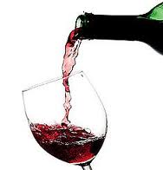
2010 Julicher, Pinot Noir, 32,80€
Medelfyllig, medelhöga tanniner, bärig, kryddig,
ekig, lång
Alkohol: | 14,50 %
Extrakt: | 31 g/l
Syror: | 0,2 g/l
Energi: | 90 kcal / 100 ml (390 kJ / 100 ml)

Slide 18
2010 Julicher, Pinot Noir
Julicher Estate Pinot Noir 2010 (SOLD OUT)
Viticulture - This Pinot Noir is a blend of different clones sourced from different blocks in our vineyard. The grapes were hand-harvested at maximum ﬂavour maturity
Winemaking - The grapes were hand-harvested and de-stemmed into small open top vats for fermentation. The must received a 4 to 5 day cool pre-fermentation maceration before the fermentation begun. The cap was treated with a punch down 3 times daily during the peak of fermentation. After fermentation finished, the wine was pressed to new and old French oak barrels for maturation and underwent complete malolactic fermentation in the spring. The wine was racked off lees and blended, minimal fined, and filtered for clarity.
Colour - Dark Cherry Red
Palate - Spicy and sweet fruit aromas of black cherry and plums. Rich, balanced and elegant wine with silky tannins, and a long lingering finish.
Aroma - Perfumed, earthy and spicy with cherries, plums, dried herbs and violets.
Variety and Clones - Pinot Noir clones Abel, 115 and 777
Harvest dates - 21- 27 /04/2010
Harvest Analysis - Brix 24-24.2 pH 3.40-3.60 TA 7.8-9.6 g/L
Oak Maturation - 10 months in 35% new French oak
Bottling Date - 13/04/2011
Wine Analysis - Alc. 13.5% pH 3.78 TA 5.6g/L
Cellaring Potential - Drink from now until 2020

Slide 19
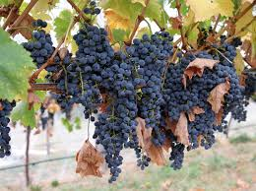
Tack!

